Slide 1
Biodiversity

Slide 2
Main types of life
Many people often think of 2 major kinds of life: Plants and Animals. Scientists, however, group living things on the basis of evolutionary relationships into five kingdoms:
  monera
  protista (protists)
  fungi
  plantae (plants)
  animalia (animals)

Slide 3
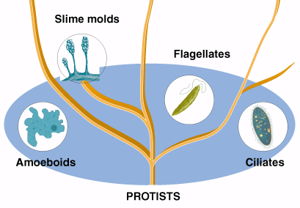
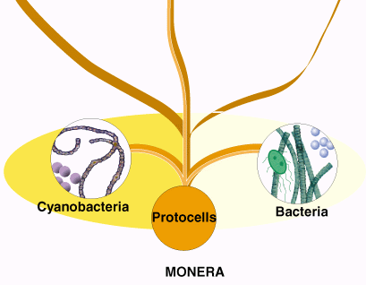
Five Kingdoms……contd
monera: single–celled, microscopic prokaryotic organisms, in particular bacteria and cyanobacteria;
protista (protists): mostly single–celled eukaryotic organisms, such as diatoms, amoebas, golden–brown & yellow–green algae and protozoans.
© Brooks/Cole Publishing Company / ITP

Slide 4
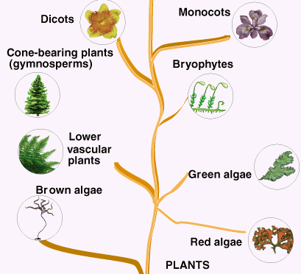
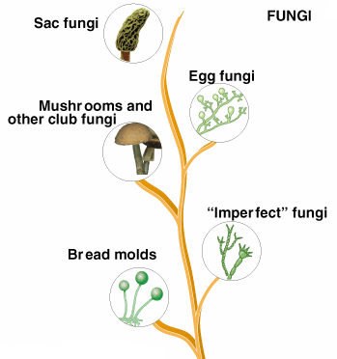
Five Kingdoms ……contd
fungi: mostly many–celled (some single–celled) eukaryotic organisms, such as mushrooms, yeasts.
plantae (plants): mostly many–celled eukaryotic organisms, such as red, brown and green algae, mosses, ferns, and flowering plants.
© Brooks/Cole Publishing Company / ITP

Slide 5
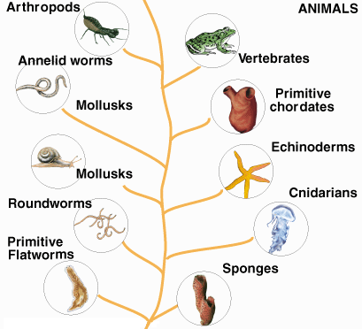
Five Kingdoms ……contd
animalia (animals): many–celled eukaryotic organisms, including invertebrates (e.g., sponges, jellyfish, mollusks, worms, arthropods) and vertebrates (e.g., fish, amphibians, reptiles, birds and mammals).
© Brooks/Cole Publishing Company / ITP

Slide 6
Main types of life
However, new evidence from the fossil fuel records and studies in molecular biology suggest that it may be more appropriate to describe life as exists in three major domains:
Eukaryota, which includes plants, animals, fungi, or protists.
Bacteria, and
Archaea - a group of single-celled microorganisms
Animals and plants make up most of the known species.

Slide 7
Why is Earth "just right" for life?
distance from sun: leads to a temperature range favorable to life (between freezing and boiling point of water); energy flow from sun sufficient to drive weather and supply energy for life;
size: enough gravitational mass to hold its atmosphere of light molecules (N₂, O₂, CO₂, and H₂O) and to keep its core molten;
rotation: leads to daily patterns (night & day);
orbit around sun: leads to seasonal patterns;
atmospheric evolution: accumulation of O₂ in lower atmosphere; formation of ozone shield to screen harmful ultraviolet (UV) radiation.
© Brooks/Cole Publishing Company / ITP

Slide 8
Biological Evolution:
Biological evaluation refers to the change in inherited characteristics of a population from generation to generation. Biological evaluation is one of the features that distinguish life from everything else in the universe.
According to the theory of biological evaluation, new species arise as a result of competition for resources and the difference among individuals in their adaptations to environmental conditions.
Biological evaluation explains the diversity of different species that exist today.

Slide 9
Biological Evolution: Natural Selection
Natural selection occurs when some individuals in a population have genetically favorable traits (genes and characteristics of organisms) that increase their chances of survival;
There are 3 types of Natural Selection.
Notes:
A trait is a distinct variant of a phenotypic character of an organism that may be inherited, environmentally determined or somewhere in between. For example, eye color is a character or abstraction of an attribute, while blue, brown and hazel are traits.
A phenotype is an organism's observable characteristics or traits: such as its morphology, development, biochemical or physiological properties, behavior, and products of behavior
The genotype of an organism is the inherited instructions it carries within its genetic code. Not all organisms with the same genotype look or act the same way because appearance and behavior are modified by environmental and developmental conditions. Similarly, not all organisms that look alike necessarily have the same genotype.

Slide 10
1. Directional Natural Selection
Changing environmental conditions cause a shift so that individuals with one extreme end of the spectrum become more common than “mid-range” organisms;
A useful example can be found in the breeding of the greyhound dog. Early breeders were interested in dog with the greatest speed. They carefully selected from a group of hounds those who ran the fastest. From their offspring, the greyhound breeders again selected those dogs who ran the fastest. By continuing this selection for those dogs who ran faster than most of the hound dog population, they gradually produced a dog who could run up to 64km/h (40mph).

Slide 11
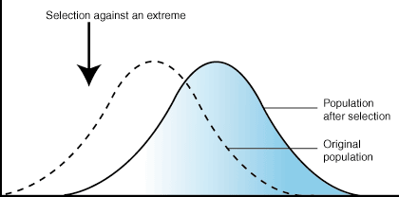
1. Directional Natural Selection…

Slide 12
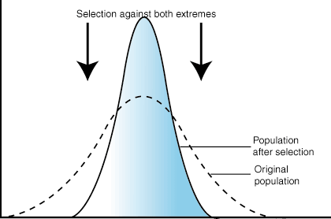
2. Stabilizing Natural Selection
Tends to eliminate organisms on both ends of the spectrum, and favors organisms with “mid-range” traits;
Most often occurs when the environment changes little, or most members of the population are well adapted to their environment;

Slide 13
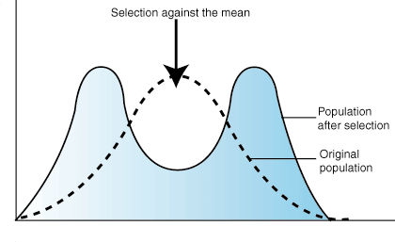
3. Diversifying Natural Selection
Favors organisms with traits on either end of the spectrum;
A population is generally splited into two groups with this type of natural selection.

Slide 14
How do new species evolve?
Speciation, which derives from natural selection that allows species to come out of one species;
Speciation is the process of generating a new species. Takes place in two phases, Geographic Isolation and Reproductive Isolation;
Geographic Isolation occurs when groups of the same species are physically separated for long periods of time. This can be due to migration, or physical barriers;
Reproductive Isolation occurs when two geographically isolated populations can no longer reproduce with one another. This happens when mutations and natural selection act independently on the two populations. This process as a whole is called Divergence, or Divergent Evolution.

Slide 15
Geographic Isolation
  Geographic isolation can occur due to a variety of reasons:
  Long Term -- Uplifting mountains, rerouting of rivers, formation of deserts;
  Short Term -- Fallen tree, plowed field.

Slide 16
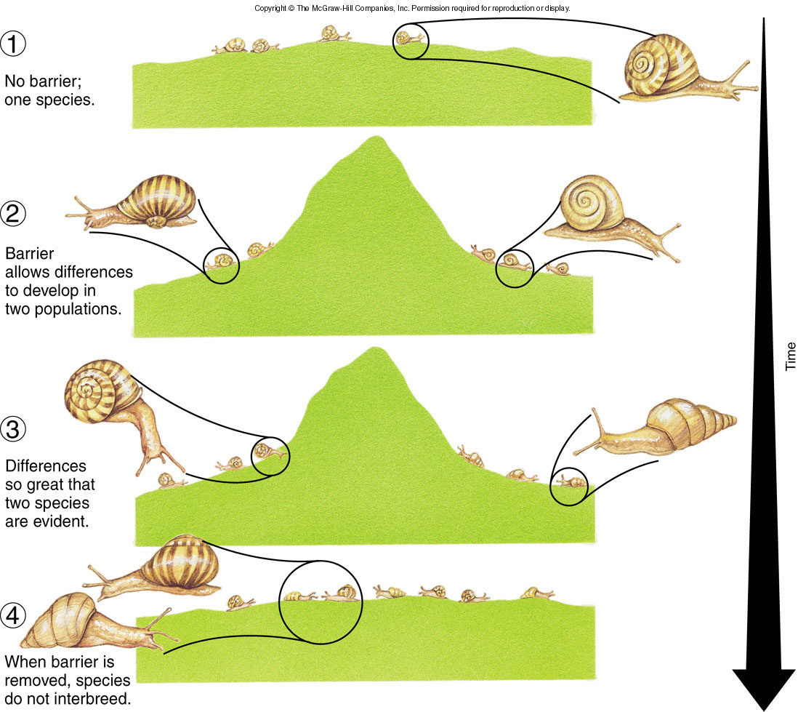

Slide 17
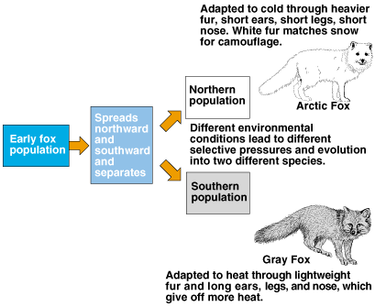
Speciation
Geographic isolation can lead to reproductive isolation, divergence and speciation.
© Brooks/Cole Publishing Company / ITP

Slide 18
REPRODUCTIVE ISOLATION
Reproductive isolation (genetic isolation) occurs if the genetic differences between the two populations become so prominent that reproduction cannot occur if they are brought together.

Slide 19
Isolating Mechanisms
Reproductive isolating mechanisms -- barriers that prevent genetic exchange between species. 2 types:
  Pre-zygotic isolating mechanisms
    Prevent the formation of zygotes
  Post-zygotic isolating mechanisms
    Prevent the proper functioning of zygotes after they are formed

Slide 20
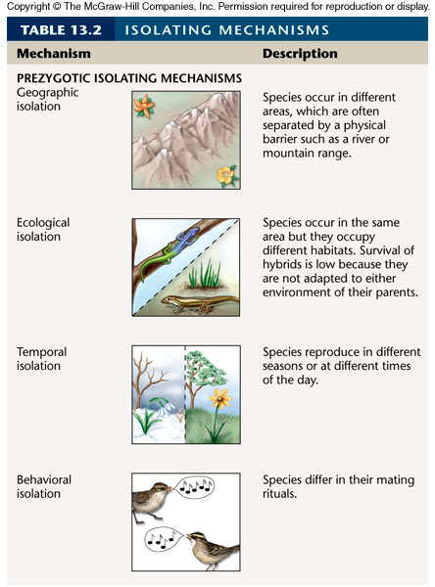
Pre-zygotic Isolating Mechanisms

Slide 21
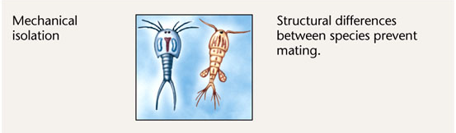
Pre-zygotic Isolating Mechanisms

Slide 22
Biodiversity
Biodiversity: Biological diversity or biodiversity - is a term we use to describe the variety of life on Earth. It refers to the wide variety of ecosystems and living organisms: animals, plants, their habitats and their genes (A gene can be defined as a region of DNA that controls a hereditary characteristic).
Biodiversity is everywhere. It occurs both on land and in water, from high altitudes to deep ocean trenches and it includes all organisms, from microscopic bacteria to more complex plants.
Speciation is responsible for the vast number of species that we have on earth today.

Slide 23
Genetic Diversity
Genetic diversity refers to both the vast numbers of different species as well as the diversity within a species. The greater the genetic diversity within a species, the greater that specie’s chances of long-term survival.
This is because negative traits (such as inherited diseases) become widespread within a population when that population is left to reproduce only with its own members.

Slide 24
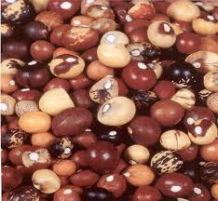
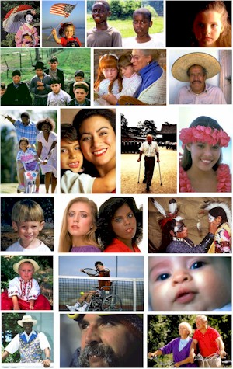
Genetic diversity in the bambara groundnut
Genetic Diversity within the human

Slide 25
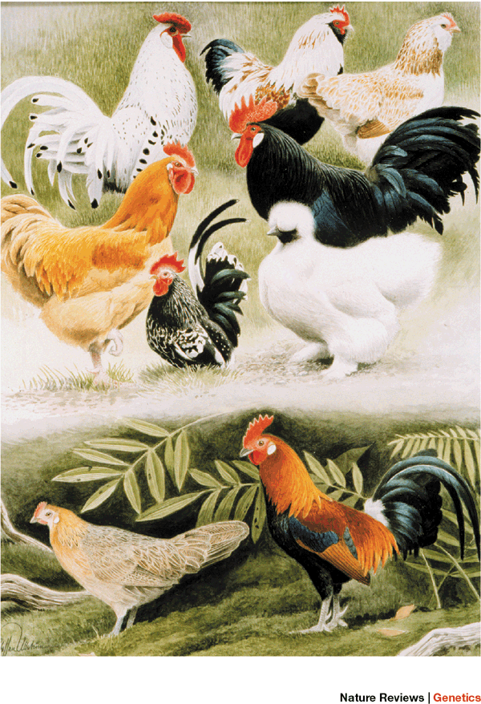
Phenotypic Diversity
Phenotype - the physical constitution of an organism that results from its genetic constitution (genotype) and the action of the environment on the expression of the genes.
The phenotype of an organism depends on which genes are dominant and on the interaction between genes and environment.
Thus, phenotypic diversity refers to variation in the physical traits of the organism.
Domroese ©AMNH-CBC

Slide 26
Species diversity vs. richness
Species diversity is an index that incorporates the number of species in an area and also their relative abundance.
The most common index of species diversity is a family of equations called Simpson's Diversity Index. Here is one such example:
D = (n / N)²
Where n is the total number of organisms of a particular species and N is the total number of organisms of all species. D is the value of diversity.

Slide 27
Anthropogenic effect on species diversity
Humans have a huge effect on species diversity; the main reasons are:
  Destruction, modification and fragmentation of habitat;
  Introduction of exotic species;
  Overharvesting;
  Global climate change.

Slide 28
Species richness
Species richness is the number of different species in a given area. Species richness is the fundamental unit in which to assess the homogeneity of an environment.
Typically, species richness is used in conservation studies to determine the sensitivity of ecosystems and their resident species.
Many people use the term “species diversity” when they mean species richness.

Slide 29
How many species are on Earth?
Though taxonomists have been cataloguing plants and animals for more than 250 years, they still have no exact answer to the question, “How many species are on Earth?”
Estimates range from 5 to 100 million; science has identified only 2 millions.

Slide 30
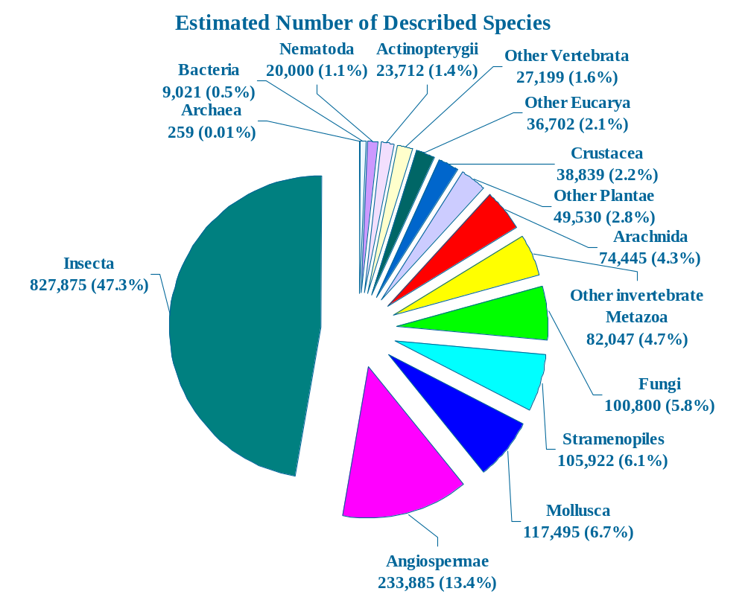
How many species?

Slide 31
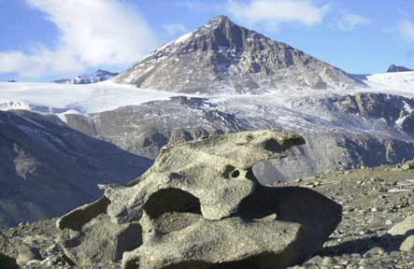
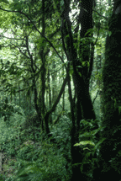
Global Biodiversity Gradient
Biodiversity is not distributed evenly across the planet:
Source: Kristan Hutchison,NSF: US Antarctic Program
Species diversity is lowest near the poles, and increases toward the tropics, reaching a peak in tropical rain forests (may contain more than half the species on Earth).
Source: Sterling ©AMNH-CBC

Slide 32
Environmental Factors that Influence Diversity
Factors that tend to increase diversity
  A physically diverse habitat.
  Moderate amounts of disturbance.
  A small variation in environmental conditions.
  High diversity at one trophic level, increasing the diversity at another trophic level.
  Middle stages of succession.

Slide 33
Environmental Factors that Influence Diversity
Factors that tend to decrease diversity
Environmental stress/Extreme environments.
Extreme amounts of disturbance.
Introduction of exotic species.

Slide 34
Endemism
Endemism is the ecological state of being unique to a particular geographic location, such as a specific island, habitat type, nation or other defined zone. To be endemic to a place or area means that it is found only in that part of the world and nowhere else.
For example, all species of lemur are endemic to the island of Madagascar. There are 50 species, all native to the island. Physical, climatic, and biological factors can contribute to endemism.

Slide 35
Endemism….contd
A species is endemic to a certain region if its distribution is restricted to that region.
There are two subcategories of endemism - paleoendemism and neoendemism.
Paleoendemism refers to a species that was formerly widespread but is now restricted to a smaller area.
Examples of paleoendemics are the gymnosperm ginkgo (preserved only in eastern Asia). The ginkgo is the only extant representative of a formerly extensive group of plants.

Slide 36
Endemism….contd
Neoendemism refers to a species that has recently arisen such as a species that has diverged and become reproductively isolated, or one that has formed following hybridization and is now classified as a separate species.
Neo-endemism is more common in plants.

Slide 37
Nature of Endemic species
Endemic types or species are especially likely to develop in islands because of their geographical isolation. This includes remote island groups, such as Hawaii.
Endemism can also occur in biologically isolated areas such as the highlands of Ethiopia, or large bodies of water like Lake Baikal.
Endemics can easily become endangered or extinct because of their restricted habitat and vulnerability to the actions of man, including the introduction of new organisms.

Slide 38
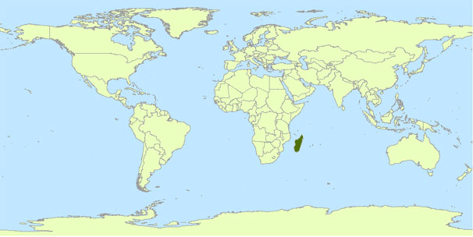
Endemism in Madagascar
Source: Koy ©AMNH-CBC
The island of Madagascar is often considered to be an area of high conservation priority in the world because the majority of species are endemic.

Slide 39
Extinction
In biology and ecology, extinction is the end of an organism or of a group of organisms (taxon), normally a species. The moment of extinction is generally considered to be the death of the last individual of the group.
Extinction occurs when conditions change, and a species must either evolve, or move to a more favorable area. If not, they will become extinct.
Extinction: 2 types
Background & Mass Extinction

Slide 40
Extinction….
Background Extinction occurs when localized environmental conditions change, and a certain number of species die at a low rate;
Mass Extinction occurs when species die at huge rates (between 25-75% of all species) due to a catastrophic event. These are often followed by Adaptive Radiations, where numerous new species emerge. But the problem is Adaptive Radiation takes 5 million years or more.

Slide 41
Extinction…
Mass extinctions are relatively rare events; however, isolated extinctions are quite common.
Only recently have extinctions been recorded and scientists have become alarmed at the high rates of recent extinctions.
Some scientists estimate that up to half of presently existing species may become extinct by 2100 if the business as usual scenario continues.

Slide 42
Factors Affecting Extinction
Natural Extinctions
  Climate change
  Cataclysmic event (volcano, earthquake)
Human Activities
  Habitat Loss/Fragmentation
  Introduction of exotic/invasive species
  Pollution
  Commercial harvesting
  Accidental killing
  Pet Trade
  Urbanization
  Damming/Flooding
  Agricultural conversion

Slide 43
Loss of Habitat Is the Single Greatest Threat to Species: Remember HIPPCO
Biodiversity researchers summarize the most important direct causes of extinction resulting from human activities using the acronym HIPPCO:
Habitat destruction, degradation, and fragmentation; Invasive (nonnative) species; Population growth and increasing use of resources; Pollution; Climate change; and Overexploitation.

Slide 44
Why Should We Care about the
Rising Rate of Species Extinction?
If all species eventually become extinct, why should we worry about the rate of extinction?
Because, we that know that speciation results in new species eventually evolving to take the places of those lost species through mass extinctions.
So, why should we care if we speed up the extinction rate over the next 50–100 years?

Slide 45
According to biologists, there are four major reasons why we should work to prevent our activities from causing the extinction of other species:
First, the world’s species are a vital part of the earth’s life support system. They provide natural resources and natural services that keep us and other species alive.
For example, we depend on some insects for pollination of food crops and on some birds for natural pest control. Thus, by protecting species and their habitats from extinction we are helping to sustain our own health and well-being.

Slide 46
2. A second reason for preventing extinctions resulting from human activities is that most species contribute to economic services —those services that support our economies.
For example, various plant species provide economic value as food crops, fuel wood, paper, and medicine.
According to a 2005 United Nations University report, 62% of all cancer drugs were derived from the discoveries of bio-prospectors.
Conservation biologist Michael estimates that a male lion living to age 7 generates about $515,000 in tourist dollars in Kenya, but only about $1,000 if killed for its skin.

Slide 47
A third reason for preventing extinctions caused by human activities is that analysis of past mass extinctions indicates it will take 5 million to 10 million years —25 to 50 times longer than the amount of time that our species has been around—for natural speciation to rebuild the biodiversity that is likely to be lost during this century.
4. Fourth, many people believe that each wild species has a right to exist, regardless its usefulness to us. According to this view, we have an ethical responsibility to protect species from becoming extinct as a result of human activities.

Slide 48
Biodiversity “Hot Spots”
  A biodiversity hot spot
  - Is a relatively small area with an exceptional concentration of species.
A biodiversity hotspot is a region with a high level of endemic species. Most hotspots are located in the tropics and most of them are forests.
New species are regularly discovered (on average between 5-10,000 new species/year; most of them are insects).

Slide 49
Biodiversity in Bangladesh
Bangladesh has about
  20,113 species of mammals,
  over 630 species of birds,
  125 species of reptiles
  22 species of amphibians.
  260 freshwater species and
  475 marine species.
  Other faunal species include: 327 mollusks and 66 corals.
Bangladesh has been the abode of 5000 angiosperm species and several subspecies. Of them 160 species are used as crops.

Slide 50
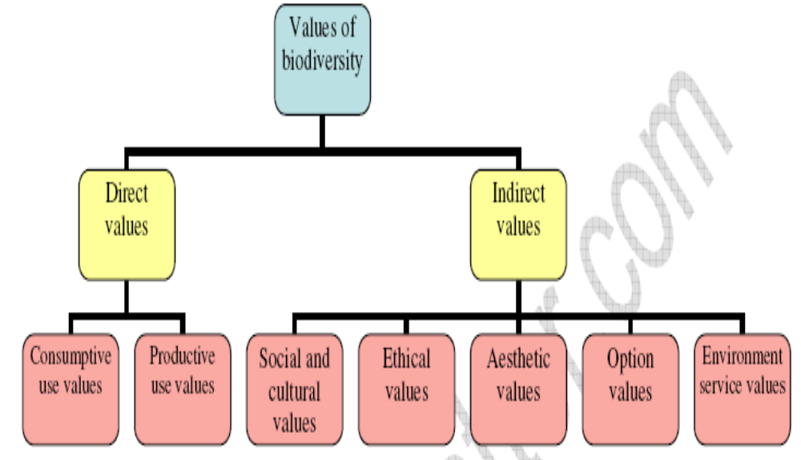
Values of Biodiversity

Slide 51
Values of Biodiversity….
Direct values
The direct values include food resources which we obtain from plants and animals. These also include other values like medicine, fuel, timber, fiber, etc.
The direct values are of two types:
(i) Consumptive use value and
(ii) Productive use value.
(i) Consumptive use value: These are the direct use values where the biodiversity products can be harvested and consumed directly. Example: Food, drugs, etc.

Slide 52
Values of Biodiversity….
(ii) Productive use value: These are the direct use values where the product is commercially sold in national and international market. Many industries are dependent upon these values. Example- Textile, leather, silk, paper and pulp industry etc.
Indirect values
Biodiversity provides indirect benefits to human beings which support the existence of biological life and other benefits which are difficult to quantify. These include social and cultural values, ethical values, aesthetic values, option values and environment service values.

Slide 53
The five major biodiversity-related conventions
Convention on Biological Diversity (CBD)
Convention on International Trade in Endangered Species (CITES)
Convention on the Conservation of Migratory Species (CMS)
Ramsar Convention (The Convention on Wetlands of International Importance, especially as Waterfowl Habitat)
World Heritage Convention (WHC)

Slide 54
Biodiversity change
Biodiversity change is caused by a range of drivers. A driver is any natural or human-induced factor that directly or indirectly causes a change in an ecosystem.
A direct driver unequivocally influences ecosystem processes. An indirect driver operates more diffusely, by altering one or more direct drivers.

Slide 55
Biodiversity change………
Important direct drivers affecting biodiversity are:
habitat change, climate change, over-exploitation, and pollution.
Drivers interact across spatial, temporal, and organizational scales, and any specific ecosystem change is driven by a network of interactions among different drivers.

Slide 56
Major reasons behind biodiversity depletion in Bangladesh
High population density, extreme poverty and unemployment;
Habitat loss, degradation and fragmentation;
Illegal poaching;
Environmental pollution and degradation;
Invasive Alien Species;
Absence of proper institutional arrangements, frameworks and monitoring;

Slide 57
Major reasons behind biodiversity depletion in Bangladesh........
Global climate change and sea level rise;
Lack of true political commitments and willingness;
Lack of people’s awareness.

